Slide 1
Understanding what factors may drive housing prices (buying-selling) in the city you live in
Notes:
At some point in our lives, most of us will be searching for buying a property. That could be for investment purposes, o for our own living. Own living there may be some other emotional factors, while investment is more numeric

Slide 2




When or where to choose to buy, can range from multiple factors
Location
Demographics
Real state
Macroeconomic

Slide 3
About my analysis
Factors analysed
Demographics: population, gender, age, nationality, avg nb of pax per home, avg nb of pax per home, avg gross inc, avg net inc
Real state: volume, avg value, avg m2, price/m2
Macroeconomic: interest rates
2021
Real state
2015

Slide 4


About Barcelona (demo)
1
Flat population increase
2015
2021
3
Average gross income
0.6%
CAGR
2015
2021
1605k
1660k
0.6%
CAGR
1.605k
1.660k
2
Avg nb people remains the same
2015
2021
≈
2.40
2.39

Slide 5
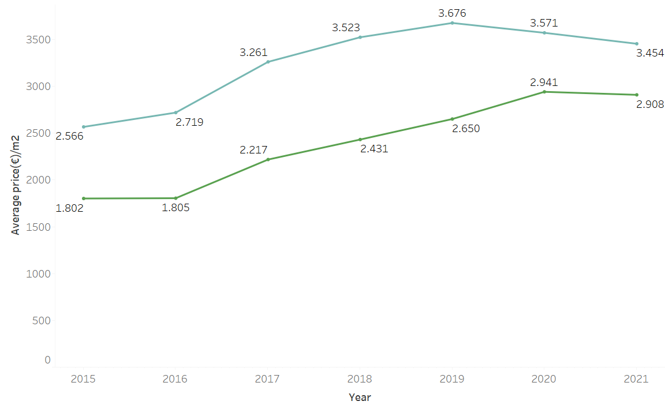
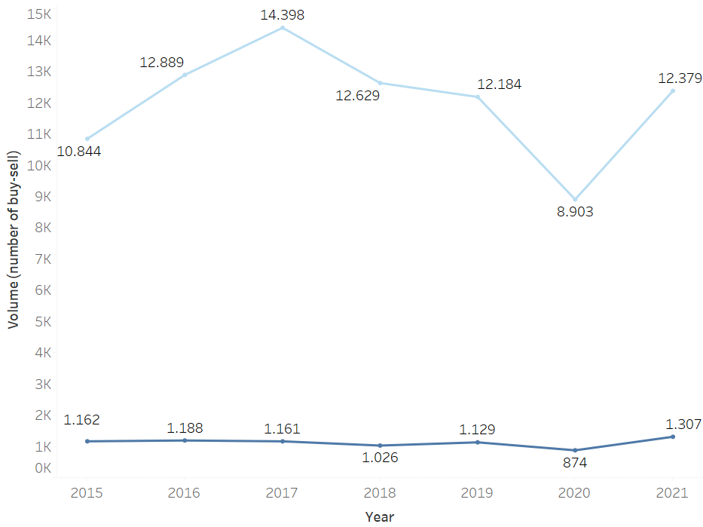
About Barcelona (demo)
Inflation? Definitely for new homes more!
volume
Price/m2
1
2015
2021
Xx%
CARG
1.605k
1.660k
If capacity is mainly driven by number of homes, this may be a reason why population is not increasing that much

Slide 6
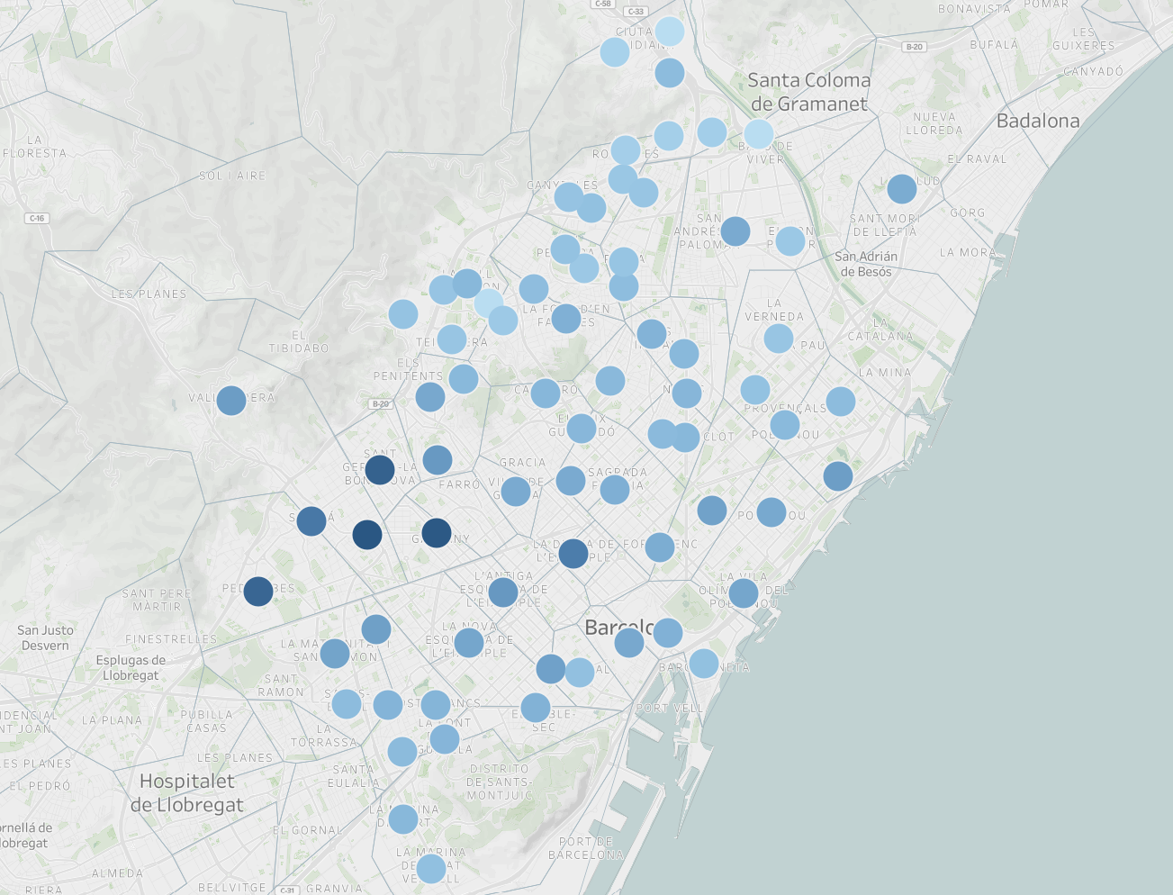
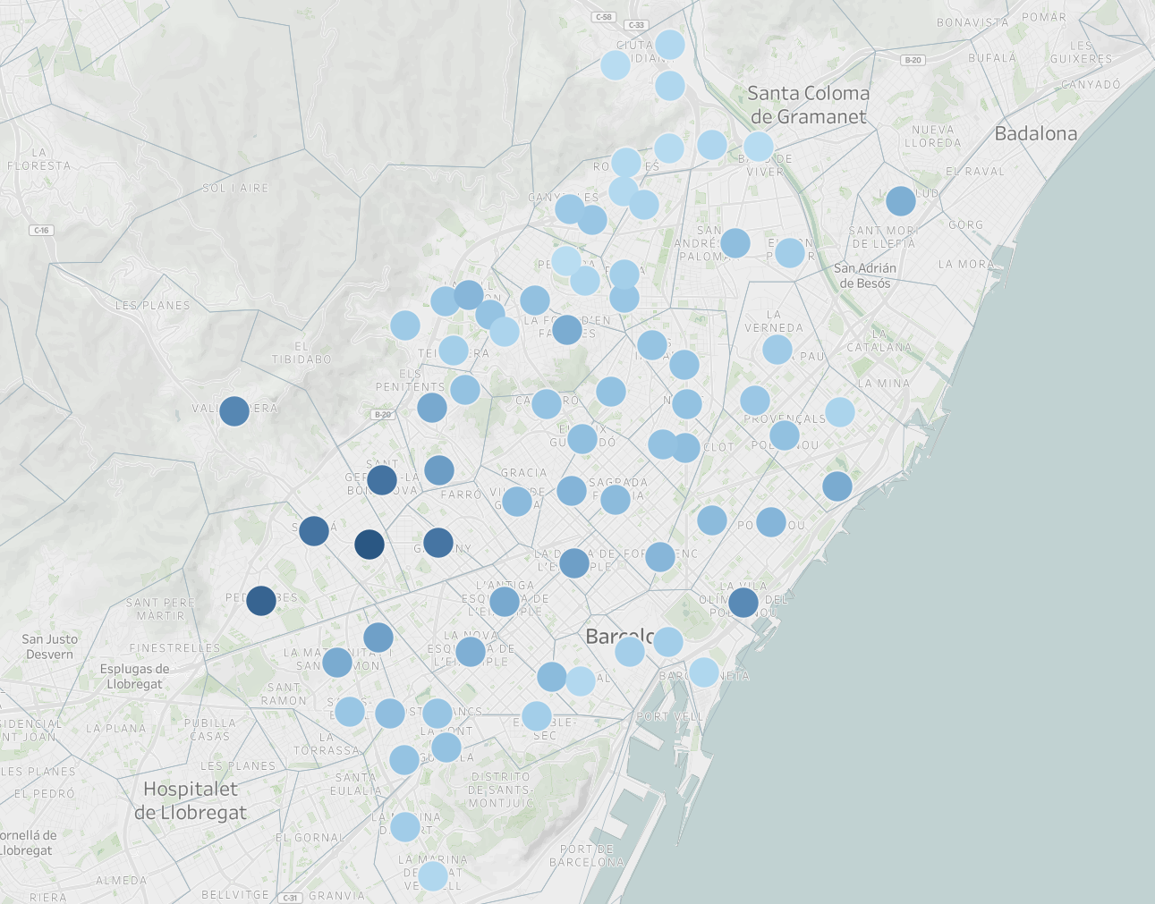


Relationship between avg gross income and avg selling price has been the highest
106
32k
104
107
30k
33k
849
102k
685
102k
815
921
913
113k
123k
100k
The more avg. gross income, the higher the avg selling price of homes in 2021

